Slide 1
In-class Exercise 14 - Texture (GLCM)
Dhiren Gupta
-800902466

Slide 2
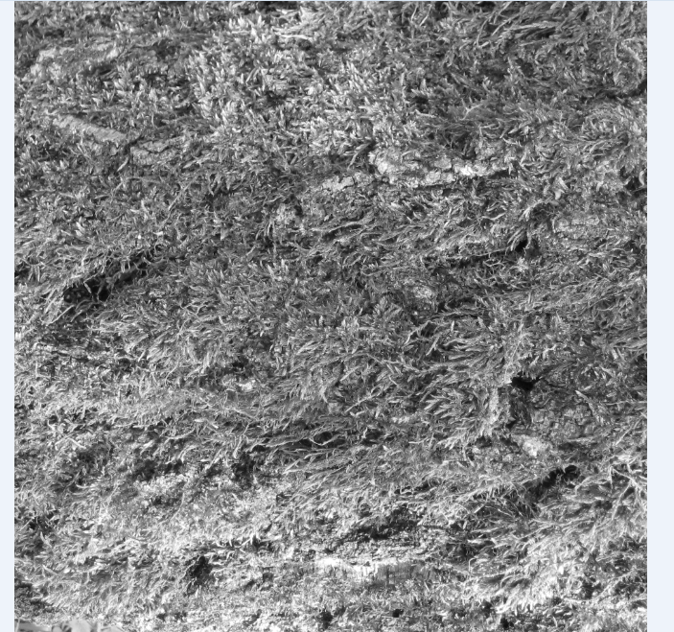
Input image

Slide 3
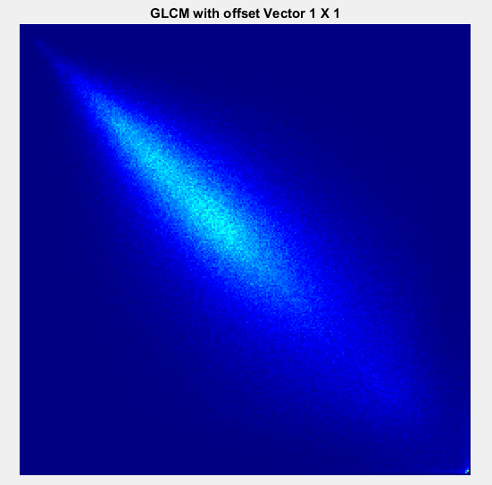
GLCM- Offset Vector 1x1

Slide 4
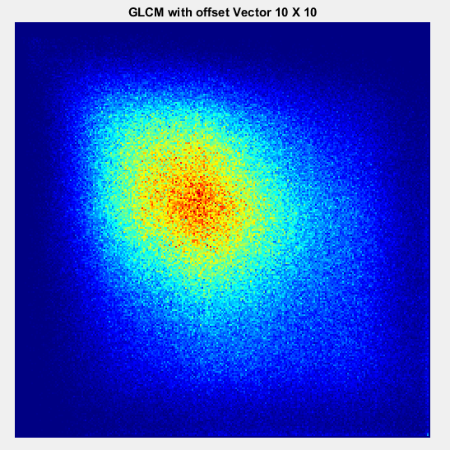
GLCM- Offset Vector 10x10

Slide 5
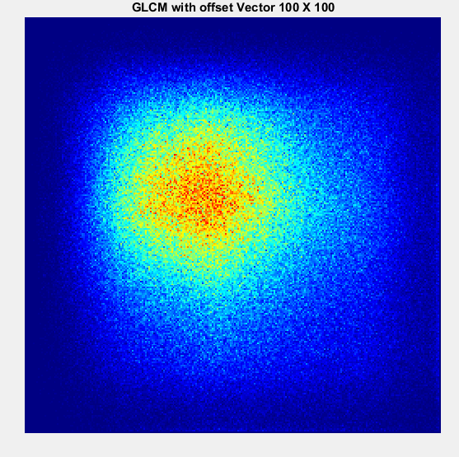
GLCM- Offset Vector 100x100

Slide 6
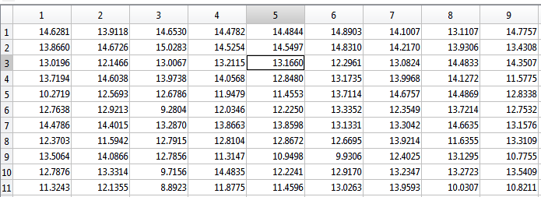
Entropy With offset Vector 20x20

Slide 7
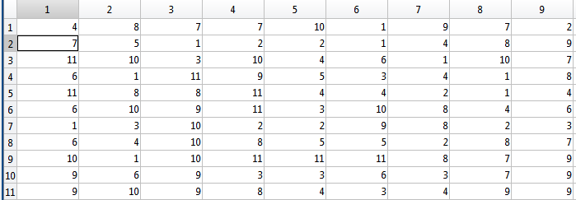
Entropy difference analysis
Here in above table if in row no is matches with column value that mean image is of same category & we are crrect.

Slide 8
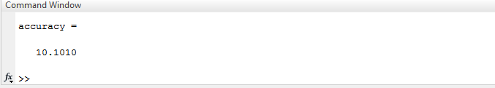
Accuracy

Slide 9
Thank You

